Slide 1

의료정보학시스템
FHIR Profiling 2
Dept. of Computer Science & Engineering
College of IT
Kyungpook National University
2017.09.25.

Slide 2
Introduction to Forge
Conformance in FHIR
Conformance Resources (“Proﬁles”) are an important aspect of the FHIR standard. They allow you to tailor FHIR to your needs and deﬁne how exchanging partners use the FHIR speciﬁcation. Proﬁles have an international, a national, regional or local scope, or are designed for speciﬁc use cases.
Proﬁle Designer
Creating and maintaining these ﬁles by hand using an XML editor or an Excel sheet is error-prone and requires detailed knowledge of the Proﬁle resource. Forge is the user-friendly editor for creating and editing proﬁles that enables modelers to create and manage proﬁles using a graphical user-interface.

Slide 3

Forge Features
Forge is the user-friendly editor for creating and editing profiles that enables modellers to create and manage profiles using a graphical user-interface.
With Forge you can:
• Create new Profiles
• Edit existing Profiles
• Define Constraints
• Define Bindings
• Define Extensions
• Define Slices
All these features will be described in more detail in the following sections.

Slide 4
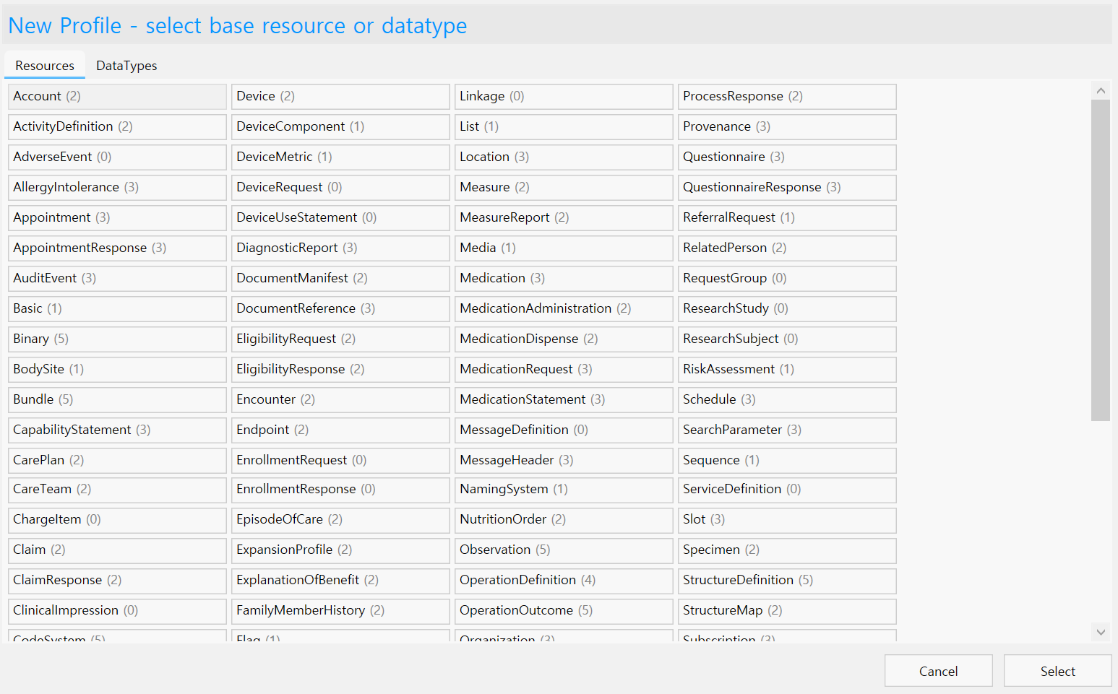
Create new Proﬁles
ForgeenablesyoutocreateyourownFHIRProﬁles,basedononeoftheFHIRbaseresources. Toopenabaseresource and start editing, you can select New Proﬁle (or Ctrl + N) from the File menu. This will open a window in which you can select one of the base Resources or DataTypes.

Slide 5
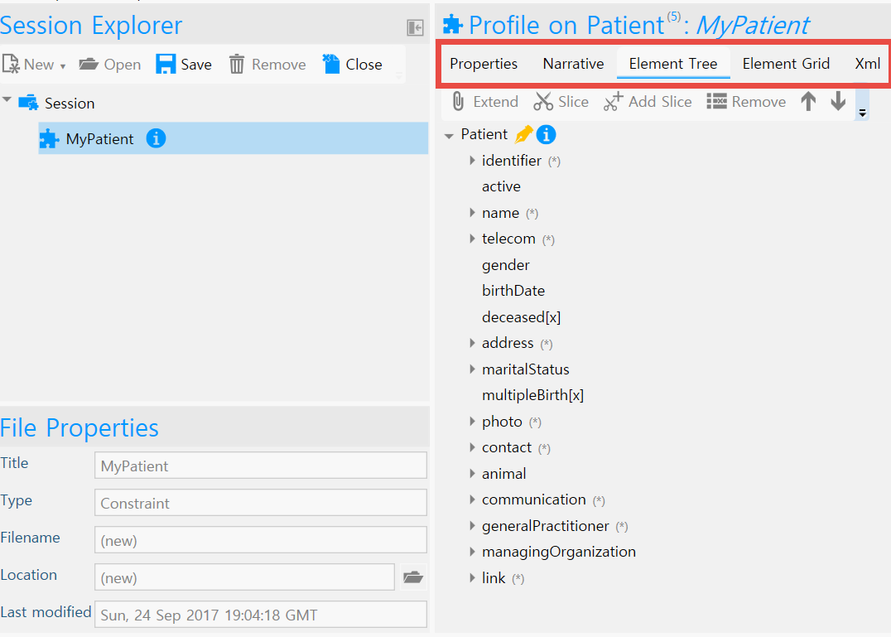
Edit proﬁles
Within Forge you can differentiate between the ﬁve tabs which are shown in the screenshot below. This section describes these tabs in more detail.

Slide 6
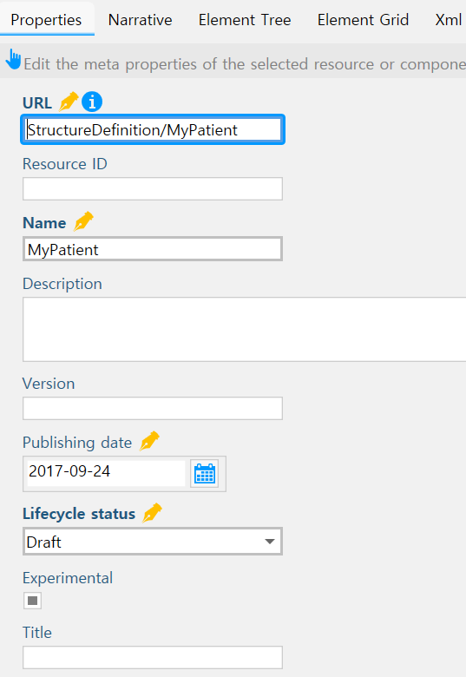
Properties
In Forge you can edit the properties of a Proﬁle as well as the elements of the Proﬁle.
Properties of the Proﬁle are, for example, the proﬁle URL, name, and publishing date. These values can be edited under the ‘Properties’ tab.

Slide 7
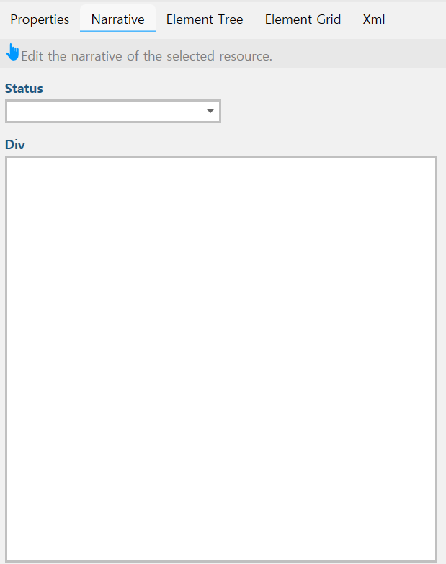
Narrative
A proﬁle’s narrative can be adjusted under the ‘Narrative’ tab. The narrative is a XHMTL fragment which is intended to contain a summary of the resource and is used to represent the content of the resource to a human. On default this is a Generated Narrative of the proﬁle, meaning the content is entirely generated from the structured data in the proﬁle.

Slide 8
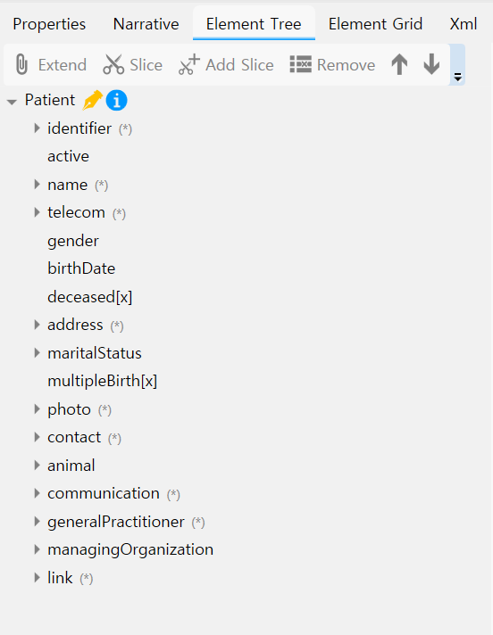
Element Tree
Elements of the FHIR base Resource and extension can be edited to make your own proﬁle. In Forge you can view and edit these elements in the Element Tree or in the Element Grid.
Via the Element Tree you can edit Element Properties, slice Elements, or add extensions.

Slide 9
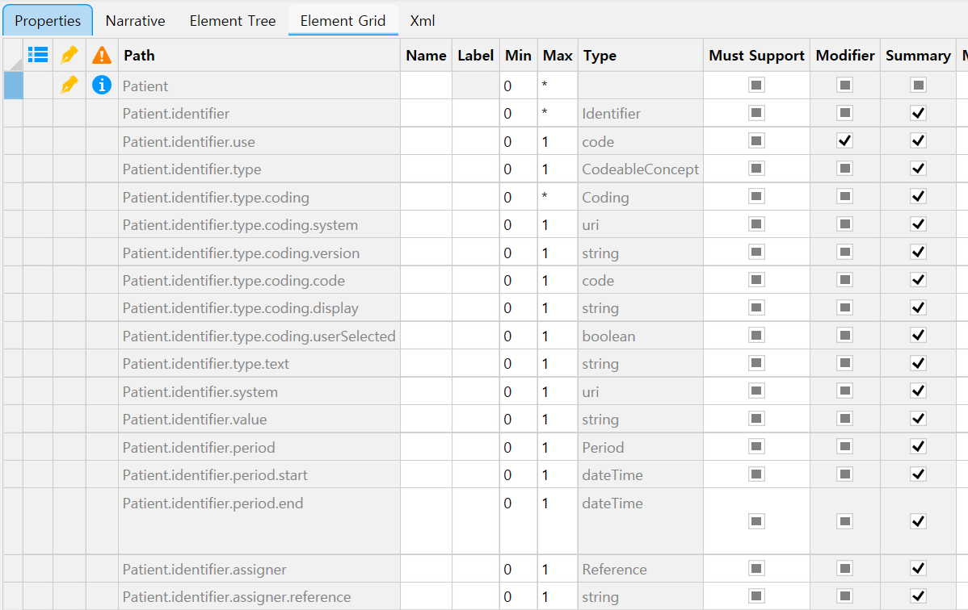
Element Grid
Elements of the FHIR base Resource and extension can be edited to make your own proﬁle. In Forge you can view and edit these elements in the Element Tree or in the Element Grid.

Slide 10
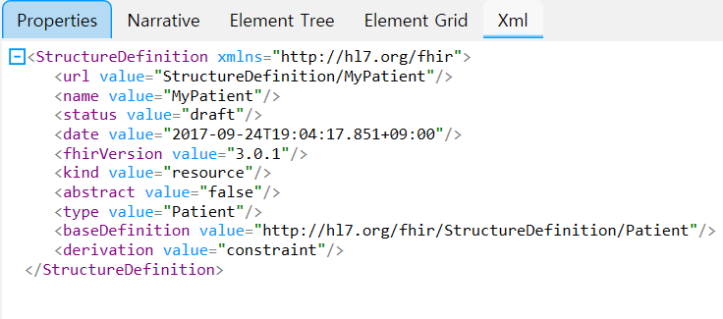
XML viewer
The last tab is the XML viewer of the current proﬁle. The XML viewer only shows the differential. A snapshot can be obtained by saving your work after the option ‘Save snapshot component’ is checked in the Options menu.

Slide 11
Deﬁne constraints
An important option for the editing of Element Properties is the option to add constraints. In Forge you can add one or more constraints to an element.
This section shows how to place cardinality constraints, edit element types and value set bindings. In addition, with Forge it is also possible to specify the Constraint Key, Requirements, Severity, Description, and XPath expression.

Slide 12
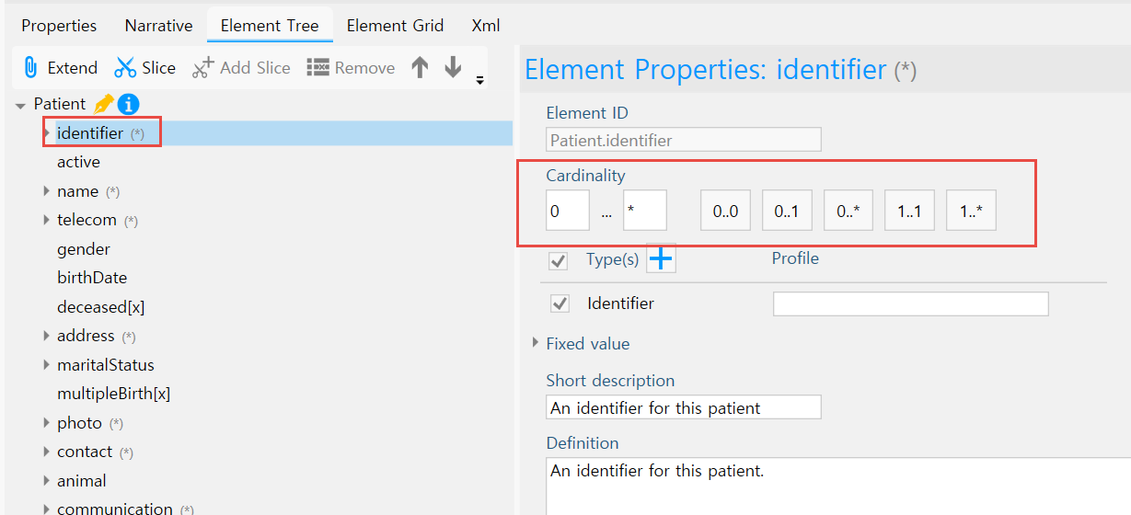
Set Cardinality
Adjusting the cardinality of an element might be the backbone in proﬁling FHIR. Forge offers the ﬁve most used cardinality options as a shortcut but it is also possible to enter the desired cadinality values in de ‘Element Properties’ as shown in the screenshot below. Note that proﬁles may only further restrict the base resource. For example, it is not allowed to make the maximum cardianlity greater than the base Resource’s maximum cardinality. Forge shows a warning message when this happens.

Slide 13
Set Element Type
Some elements in the FHIR speciﬁcation contain multiple data types. For example, the element ‘value[x]’ in the Observation resource. In your proﬁle, it is possible to constrain this to the desired data type(s).
Forge allows you to place these constraints in the Element Properties by checking only the wanted data types. The screenshot below shows the unconstraint Type situation of the ‘value[x]’ element in the Observation resource.
It is also possible to provide a custom datatype by entering the URI of the datatype proﬁle after the checked Type. A Type can also be a reference to another Resource proﬁle. Forge automatically gives the proﬁle as a Type option if the proﬁle is opened in the session explorer and the proﬁle’s base Resource ﬁts the element.

Slide 14
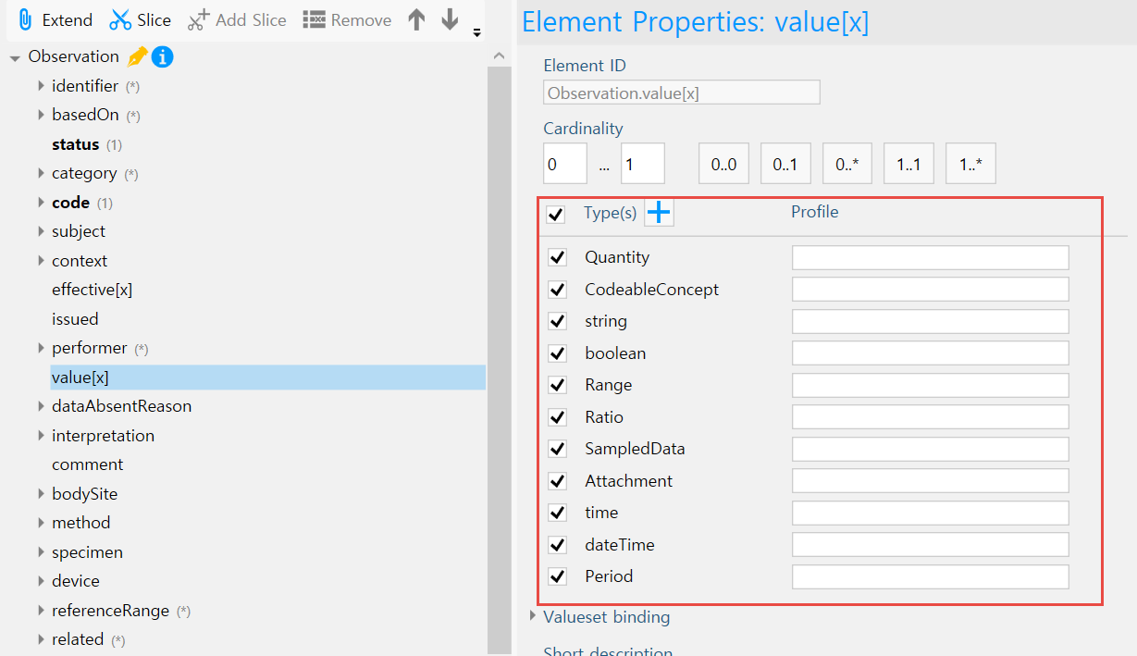
Set Element Type

Slide 15
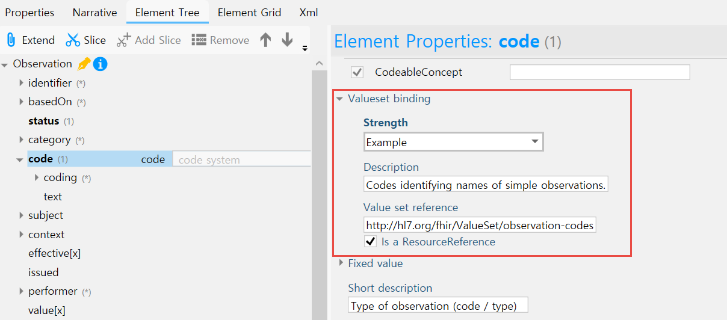
Valueset binding
Some elements can be constrained with a valueset. A valueset can be added or edited under ‘Valueset binding’ in the ‘ElementProperties’. Here you can provide the valueset binding strength, description and the reference to the valueset. Note that you cannot relax the base Resource binding strength. The value must be equal to or strichter than the base value. https://www.hl7.org/fhir/valueset.html

Slide 16
Deﬁne extensions
Within Forge you can extend your proﬁles or elements with extensions created by yourself or others. The easiest way is to ﬁrst open or create a new extension in your session explorer alongside your current proﬁle. Forge is then able to assist in linking the extension to your proﬁle.

Slide 17
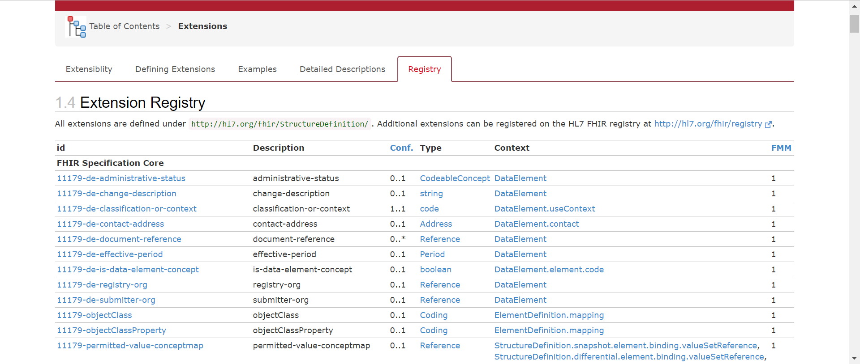
Extension registry
When using extensions, ﬁrst consult the extension registry at http://hl7.org/fhir/extensibility-registry.html or Simpliﬁer.net to ﬁnd already deﬁned extensions that may be suitable for your needs. For example, extending a Patient proﬁle with the place of birth can be done with an already existing extension found in in the HL7 extension registry.

Slide 18
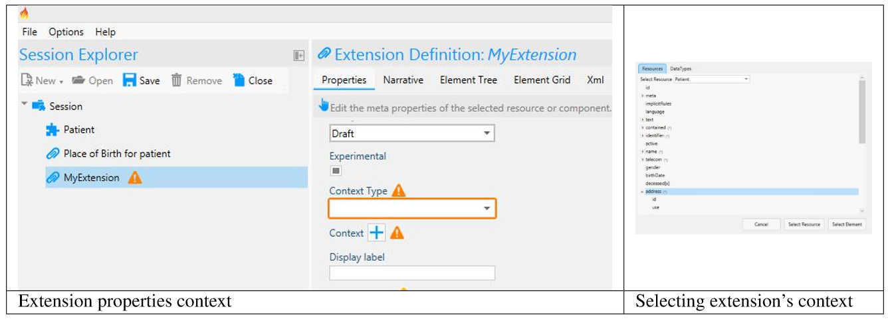
New extension
If you cannot ﬁnd an already deﬁned extension you can make your own. Go to ?New? and click ?New Extension? (or Ctrl + E) to create a new extension. Forge shows warning messages in the lower section of the your screen highlighting the need to provide context information for this new extension. Provide this information in Properties tab of the extension. ?Context Type? indicates if the extension extends a Resource, Datatype, Mapping or another Extension. Give the exact context by clicking the + symbol after Context. This brings you to a new screen were you can select the speciﬁc resource or datatype where the extension is allowed to be placed. If you extend on the resource level you can click Select Resource. If you extend an element ﬁrst select that element and then click Select Element. Depending on where the extension may be used, you can add more context information. You can provide a canonical URL, name and other relevant information in the properties section as well.

Slide 19
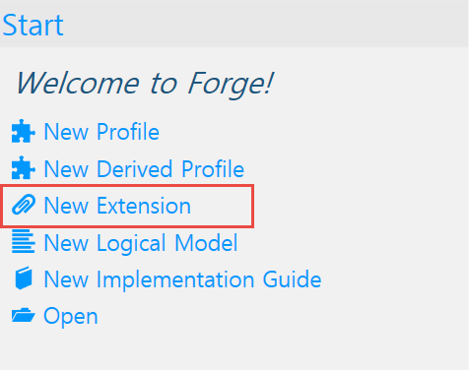
Extension proﬁle
A new extension starts with one element containing a Value[X]. A Value[X] can contain all datatypes, most likely this needs to be constrained to a more speciﬁc datatype. This can be done in the Element Properties tab by selecting the wanted datatype(s). An extension containing more elements is called a complex extension. Elements can be added and removed from the extension proﬁle with the use of the Add and Remove buttons. Added elements will be placed a level lower than the selected element

Slide 20
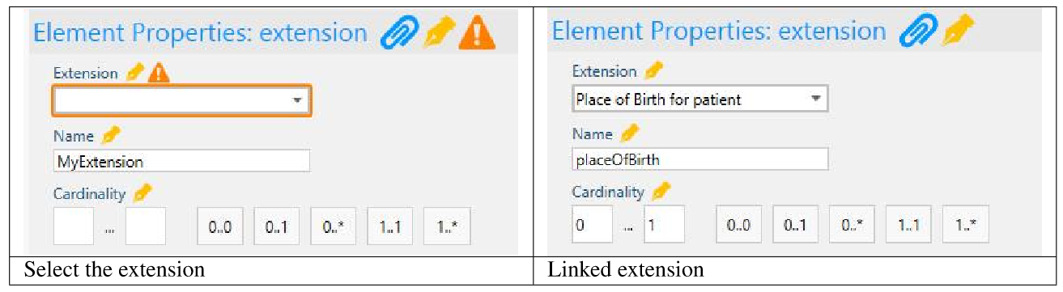
Add the extension to the proﬁle
Select the element in the Element Tree of your proﬁle where you want to add the extension. Then, click the paperclip icon with the name Extend which is shown in the tool section above the element tree. Forge shows a warning highlighting that the extension element is empty and it should be associated with an extension deﬁnition. Select the newly made extension element and click the dropdown menu in the Element Properties section under Extension. All extensions in your session explorer will be available in the dropdown menu. Click the desired extension deﬁnition. If you do not have the extension available in Forge it is also possible to provide the canonical URL of the exention here.

Slide 21
Deﬁne slices
To further customize a base Resource you can slice available elements to capture a variety of the same element. This is particularly helpful when you want to capture multiple versions of an element of your base Resource. For instance multiple patient identiﬁers or multiple name parts. This allows you to deﬁne speciﬁcs such as CodeableConcepts for each part of the sliced object. This process entails slicing a structure element into sub items. The sub items that are created are then referred to as slices.

Slide 22
Slicing in Forge
Select the element that you want to slice and click on the scissor icon. The element is now ‘Sliced’ and it is possible to add slices by clicking the scissor icon with a little plus. You can create as many slices as necessary by selecting the sliced element and clicking the Add Slice icon again. The added slices can be deﬁned and constrained as any other element.

Slide 23
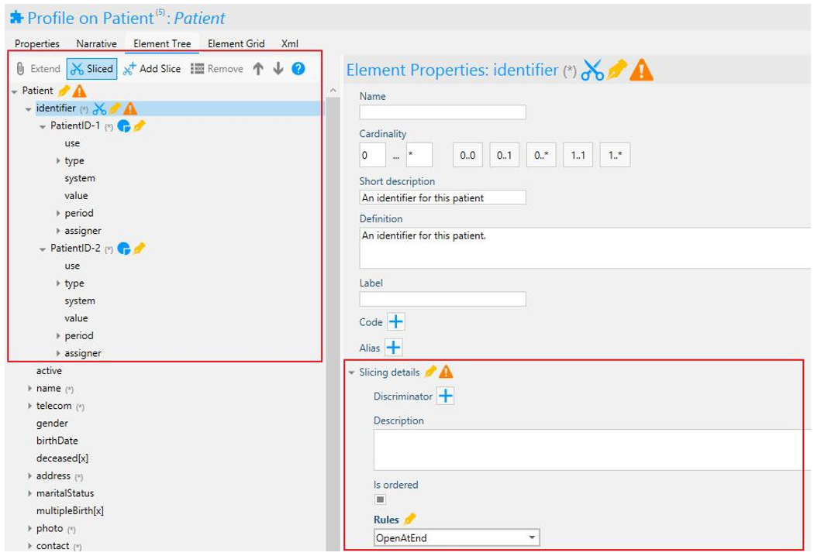
Discriminator
After adding slices, Forge shows a warning message containing the message that there is no discriminator deﬁned for the sliced elements. The discriminator is used to distinguish the sliced elements from one another. The discriminators in their sum should allow applications to easily determine which slice belong to each section. The discriminator information can be provided in the Element Properties of the sliced element under Slicing Details.
*More information concerning slicing and discriminators can be found here:
http://hl7.org/fhir/proﬁling.html

Slide 24
Type Slicing
Forge 14.7 provides improved support for so-called type slicing. This applies to so-called polymorphic “choice type” elements that support multiple data types. A choice type element has a name that ends with “[x] ”, e.g. Observation.value[x]. Using type slicing, you can deﬁne constraints for speciﬁc element types. Per deﬁnition, the slicing discriminator of a type slice is equal to “@type”. Each slice constraint you deﬁne must have a unique type.

Slide 25
Derived Proﬁles
With the new release of Forge 14.7 you now have the ability to create a proﬁle on top of another, existing proﬁle, a.k.a. “derived” proﬁle. This will enable you and your organization to beneﬁt from the existing proﬁles and to further customize those proﬁles to your speciﬁc needs. For example, take an organization that would like to begin working with a national proﬁle that is derived from a Core Resource. That organization would like to utilize the changes that were made to the Core Resource, the national proﬁle, and then further customize that proﬁle to reﬂect organization speciﬁc needs. With the new version of Forge you can now begin work directly on that national proﬁle! This saves time and effort that you would spend recreating all the changes to the Core Resource to reﬂect the changes to the national proﬁle and then further adding your organizational constraints.

Slide 26
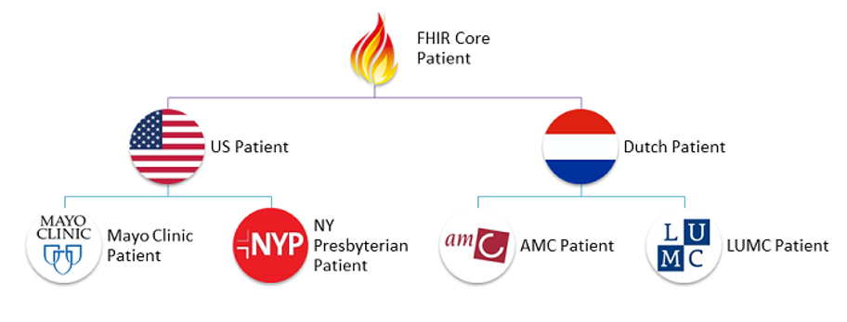
Derived Proﬁles
It works like this: You have a Core Resource. These are data models that are created to ﬁt most use cases (approximately 80% of all occurrences). A country takes that Core Resources and constrains it to ﬁt the speciﬁc needs that reﬂect the situation in their country. This then becomes that countries version of that Core Resource, this is now our national proﬁle. An organization in that country then realizes that they would like to use the national proﬁle but make a few extra constraints to reﬂect the speciﬁc situation in their centers. The organization can now use that national proﬁle and begin making changes to reﬂect their speciﬁc needs. This new organizational proﬁle will have all the inherited changes from the national proﬁle that were made to the original Core resource. This is what we refer to as a derived proﬁle.

Slide 27
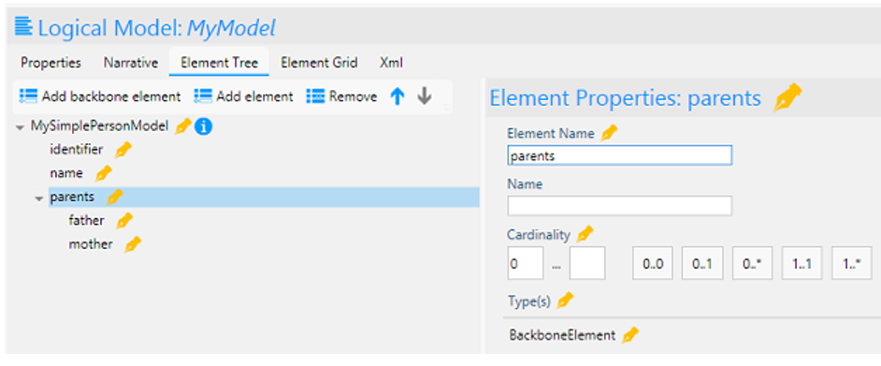
Logical Models
Forge also supports the authoring of Logical Models. A logical model represents an abstract data model that is not derived from one of the core FHIR resources or datatype.
Note: FHIR deﬁnes resources that allow you to deﬁne a mapping from a logical model to a set of FHIR resources.

